Slide 1










Thank you sponsors!
ata Saturdays

Slide 2

SQL Server 2025: Engine Deep Dive
Bob Ward, Microsoft
Danny de Haan, Redgate
aka.ms/sqlserver2025decks
github.com/ThatInfraDba/Presentations

Slide 3
























SQL Server 2025
The AI-ready enterprise database from ground to cloud
AI built-in
Develop modern
data applications
Integrate your data
with Fabric
Secure by default
Mission critical engine
Connected
with Arc
Assisted by Copilots
Benchmark
leader
Optimized for
latest hardware
Built for all
platforms

Slide 4






Frequently Asked Questions (FAQ)
When will SQL Server 2025 be Generally Available?
SQL Server 2025 is planned to be Generally Available in CY25H2
Are there any pricing and licensing changes?
We will announce pricing and licensing at General Availability (GA)
What about editions?
We will announce which features will be included in specific editions at GA. We welcome all feedback during our previews¹
How do I upgrade?
Upgrade methods will be the same as in previous releases. Supported OS and SQL versions for upgrade will be announced at GA
What about deprecated or discontinued features?
Some discontinued features have been announced. Any other deprecated or discontinued features would normally be announced at GA²
What about “BI Services?”
Power BI Report Server will replace SSRS for all paid licenses. SSAS has some new improvements. SSIS is still supported in SQL Server
1 Standard Developer Edition is now available
2 MDS, DQS, Synapse Link, Hot Add CPU, Purview Access Policies

Slide 5
Enhancing the industry proven engine
Security
Security cache improvements
OAEP support for encryption
PBKDF password hashing
Authentication using system-assigned managed identity
Backup to URL with managed identity
Managed identity support for EKM
Managed identity for AI models
Entra logins with nonunique display names
Custom password policy on Linux
TDS 8.0/TLS 1.3 support for tools and features
Performance
Optimized Locking
Tempdb space resource governance
ADR in tempdb
Persisted stats for readable secondaries
Change tracking cleanup
Columnstore index maintenance
CE feedback for expressions
Optional parameter plans optimization
DOP feedback on by default
Query store for readable secondaries
ABORT_QUERY_EXECUTION query hint
Optimized sp_executesql
Batch mode optimizations
Remove In-Memory OLTP from a database
tmpfs support for tempdb in Linux
HADR
Fast failover for persistent AG Health
Async page request dispatching
Improved health diagnostics
Communication control flow tuning
Switching to resolving state
Remove listener IP address
NONE for routing
AG group commit waiting tuning
Contained AG support for DAG
DAG sync improvements
Backups on secondary replicas
ZSTD Backup compression
Backup to Azure immutable storage

Slide 6

Performance

Slide 7
Enhancing the industry proven engine
Security
Security cache improvements
OAEP support for encryption
PBKDF password hashing
Authentication using system-assigned managed identity
Backup to URL with managed identity
Managed identity support for EKM
Managed identity for AI models
Entra logins with nonunique display names
Custom password policy on Linux
TDS 8.0/TLS 1.3 support for tools and features
Performance
Optimized Locking
Tempdb space resource governance
ADR in tempdb
Persisted stats for readable secondaries
Change tracking cleanup
Columnstore index maintenance
CE feedback for expressions
Optional parameter plans optimization
DOP feedback on by default
Query store for readable secondaries
ABORT_QUERY_EXECUTION query hint
Optimized sp_executesql
Batch mode optimizations
Remove In-Memory OLTP from a database
tmpfs support for tempdb in Linux
HADR
Fast failover for persistent AG Health
Async page request dispatching
Improved health diagnostics
Communication control flow tuning
Switching to resolving state
Remove listener IP address
NONE for routing
AG group commit waiting tuning
Contained AG support for DAG
DAG sync improvements
Backups on secondary replicas
ZSTD Backup compression
Backup to Azure immutable storage

Slide 8



Improving Application Concurrency and Availability
Optimized Locking
ABORT_QUERY_EXECUTION
query hint
Tempdb Resource Governance
Eliminate
lock escalation
Lock After
Qualification (LAQ)
Requires
ADR,RCSI,
and db option
Abort future
query execution
Stop rogue queries
from harming other users
Query Store Hint
Tempdb space usage can
grow out of control
Need to control and
isolate users
Flexibility to change
policy over time.
Fixed size or %

Slide 9
Demo: Improving Application Concurrency

Slide 10

Developers need better concurrency and don’t want to worry about locking internals

Slide 11
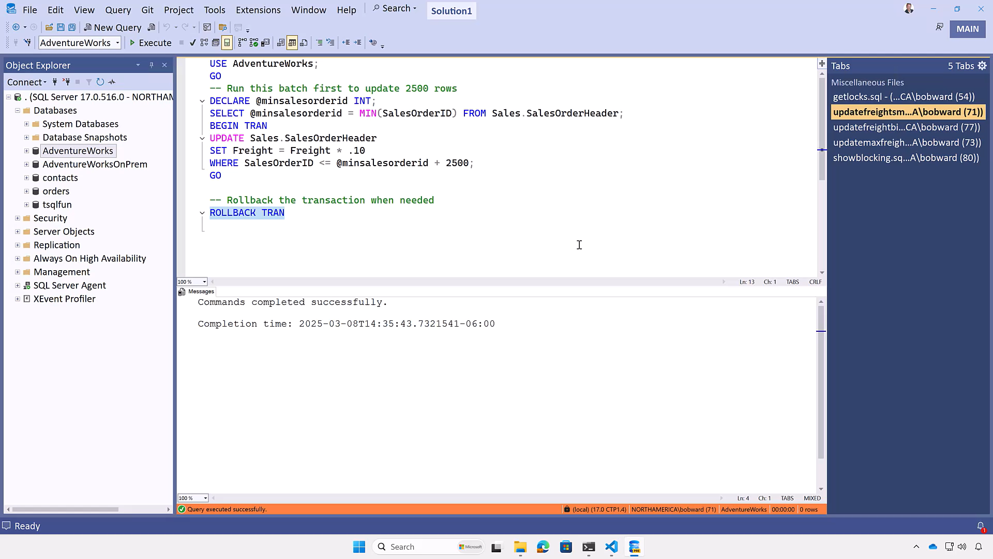
Notes:
1 min

Slide 12
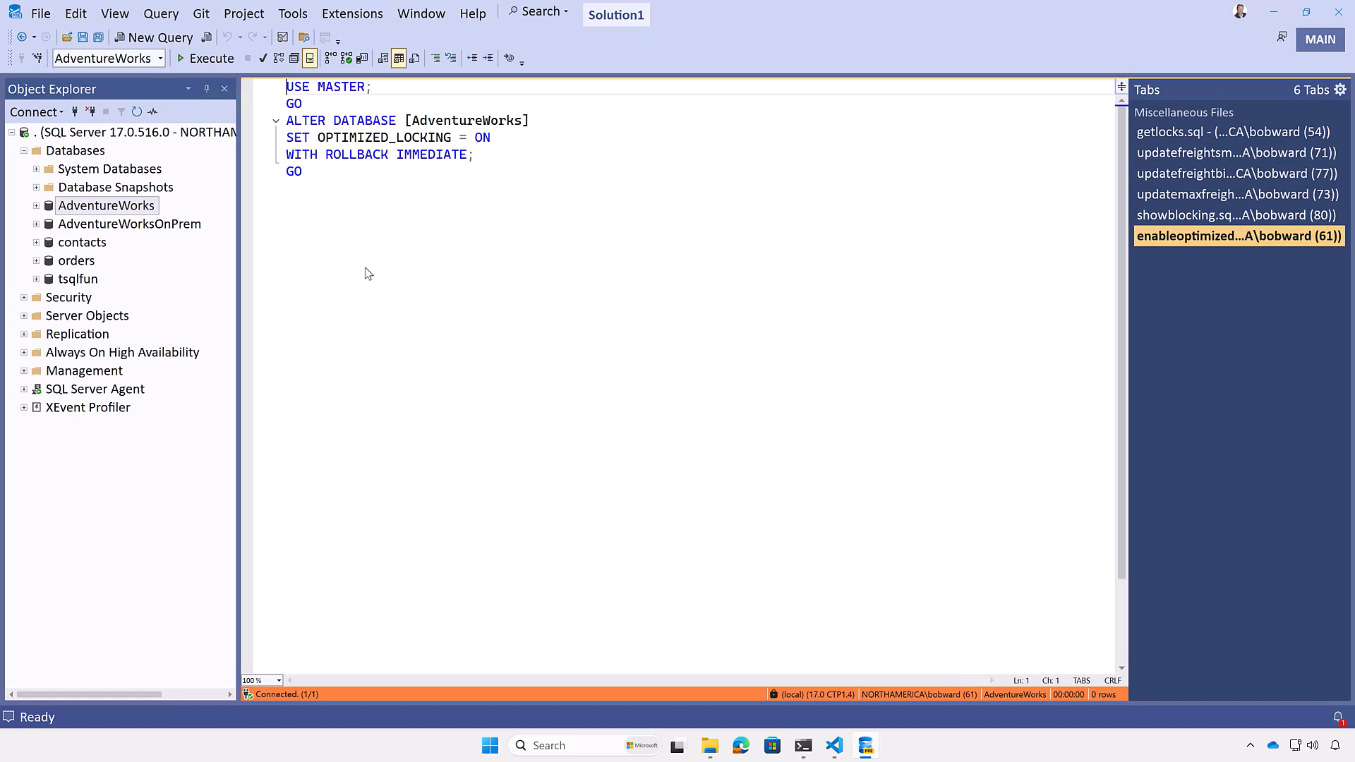
Notes:
41 secs

Slide 13
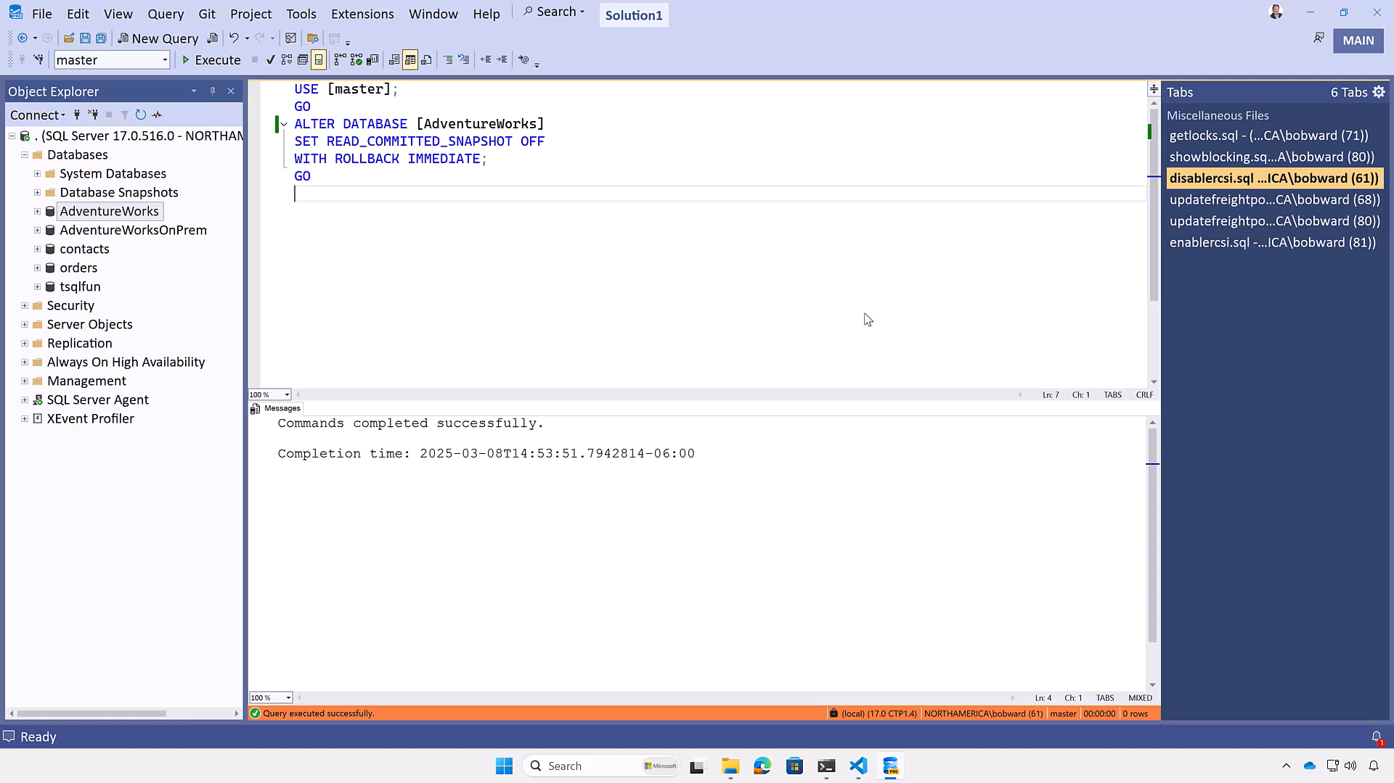
Notes:
39 secs

Slide 14
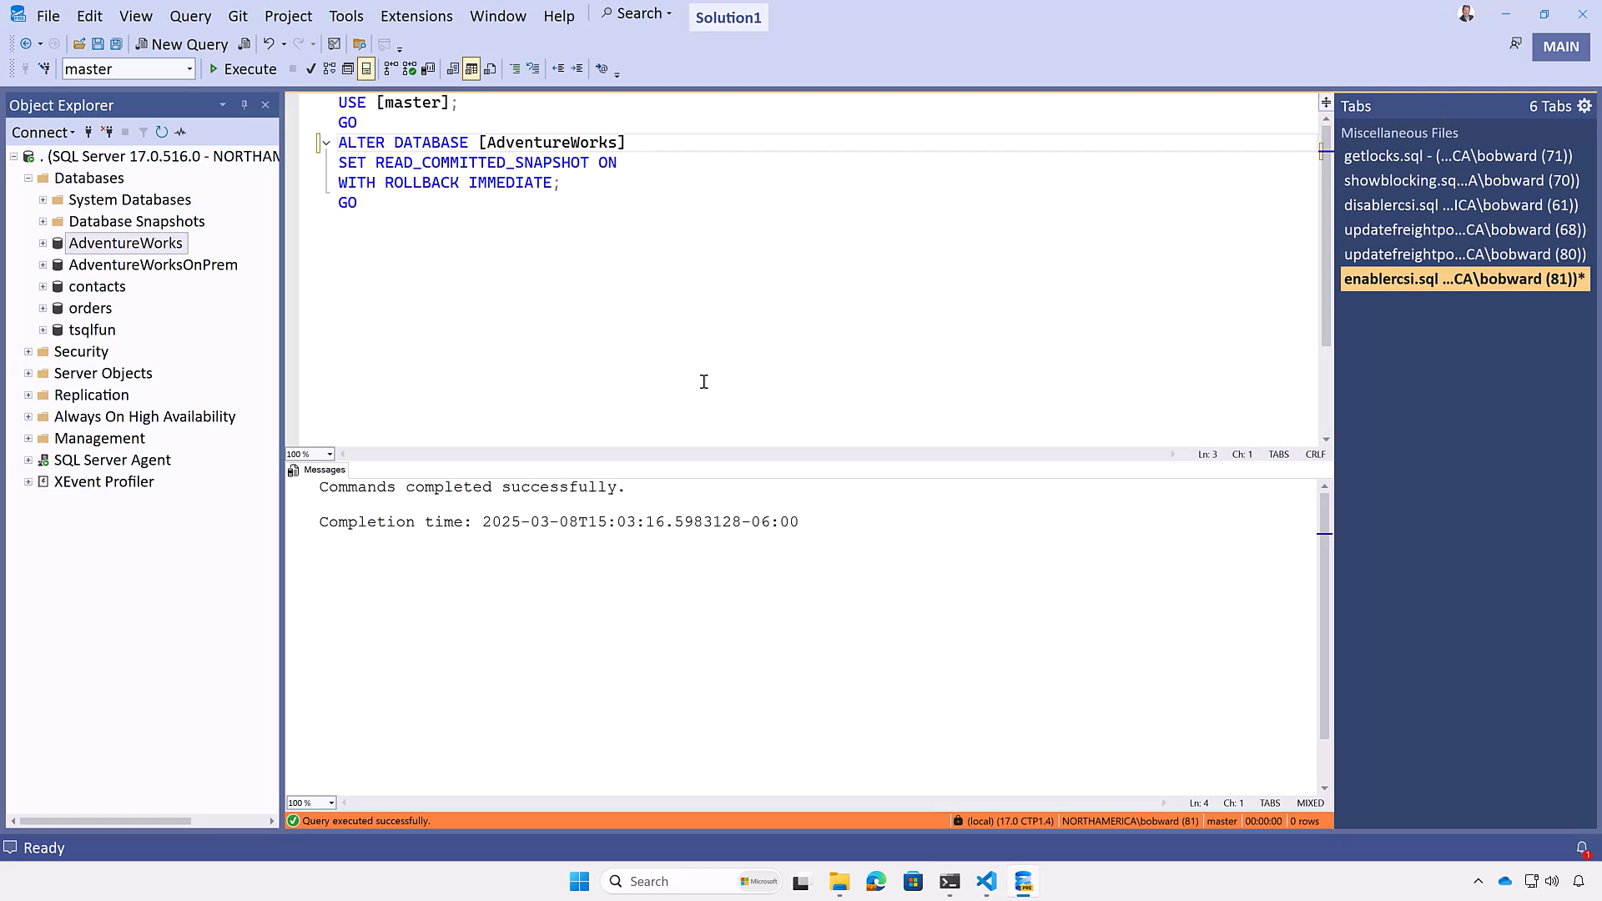
Notes:
29 secs

Slide 15
Demo: ABORT_QUERY_EXECUTION

Slide 16

Administrators need to keep servers running despite rogue queries

Slide 17
